Slide 1




Large-Scale Microtask Programming
Emad Aghayi
Department of Computer Science

Slide 2
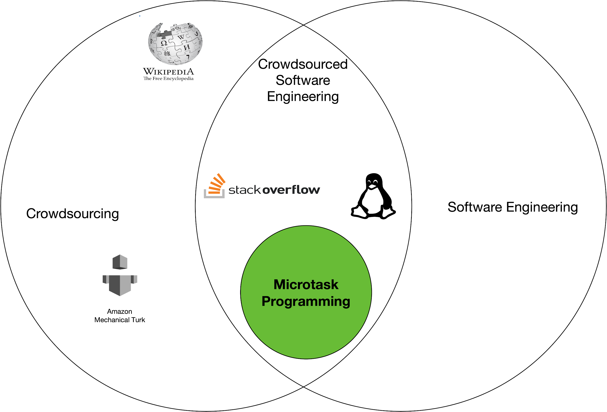
Microtask Programming: Building a software with a crowd
In this model a workflow is used to decompose tasks into a sequence of microtasks.
Research examples: CrowdCode, Apparition

Slide 3

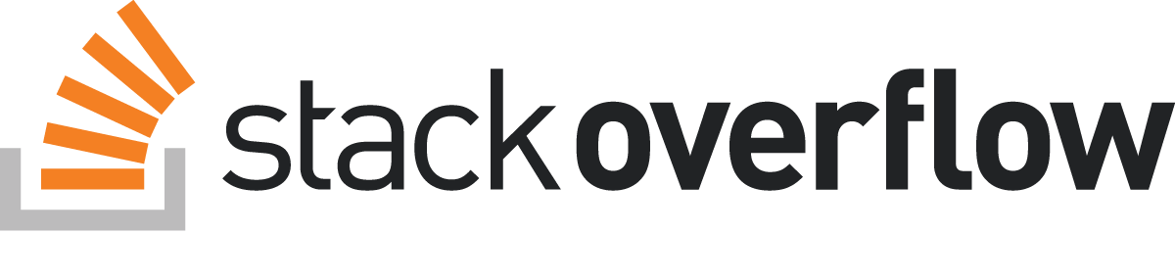
Harness power of large crowds for microtask programming
Build a large app by increasing parallelism
> 16 million users 5 days ??
Software would be built faster through many more contributors?
Challenges/requirements? Onboarding, available tasks for thousands/million developer, Coordination for avoiding conflicts, organizations of developers
Notes:
OSS onboarding barriers
Preconfigured IDE

Slide 4




Key questions
Q1: To what extent can software development work be decomposed at a granularity smaller than a commit? Apparition: design UI elements CrowdCode: work on a function API
Q2: What task context would such task require? Apparition: whole design CrowdCode: one function API
Q3: How could such work be coordinated and organized? Apparition: Todo/ locking CrowdCode: Engine, conflict
Notes:
A key challenge of microtask programming approaches is the de-contextualizing nature of programming work.
Developers work without awareness of the complete program. It means Microtask programming reduce the necessary context that developer must be learned to contribute.
The other side of coin is that it increase the potential for work going off track.
Success and failure of microtek programming strongly depends to decontextualizeing of tasks. Finding right scope of microtask is the first and most important challenge that all microtask programming address it.
Another important challenge coordination and organizing of developers.
If developers obtain feedback as quickly as possible. It ensures their contributions are beneficial and that they do not have any conflicts.
When this does not occur, problems may derive. For instance, developers may make poor implementation choices, or make implementation choices which conflict with other choices.

Slide 5
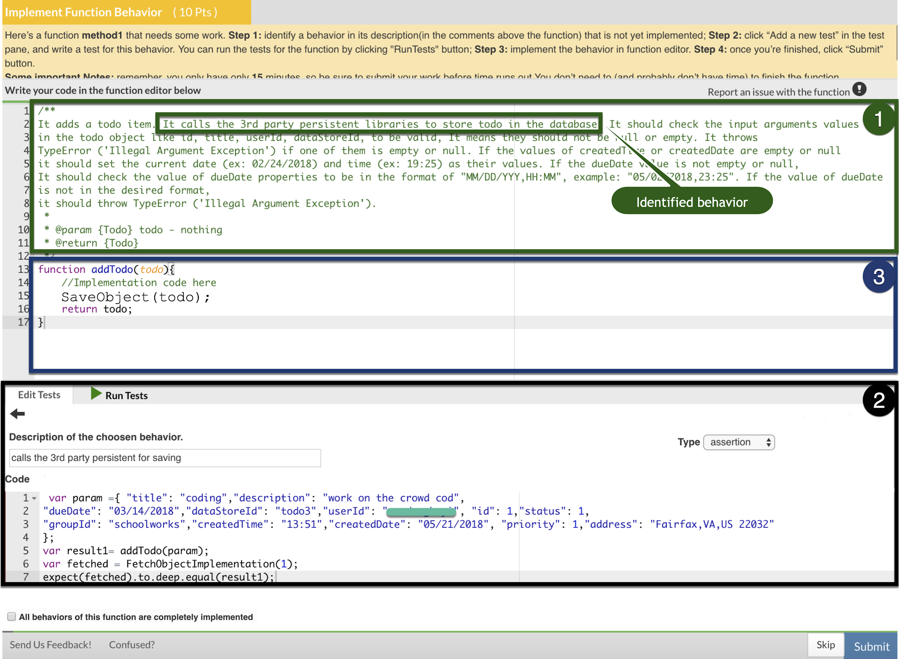

Crowd Microservices: behavior-driven microtask programming
First preconfigured IDE for implementing microservices through microtasks
Novel behavior-driven microtask programming which offers immediate feedback from syntax errors, unit tests, and debugging
Notes:
In the beginning I want to demo our microtask programming approach which is implemented in a web-based IDE that we named it Crowd Microservices.

Slide 6
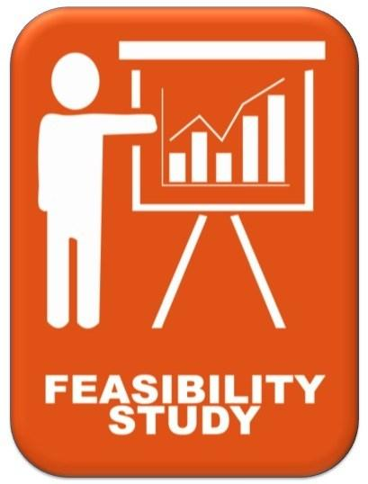

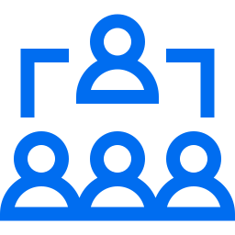
Examining microtask programming
Study 1: Does our microtask programming work?
Study 2: Microtask programming vs. traditional development
Study 3: Microtask programming in industry

Slide 7
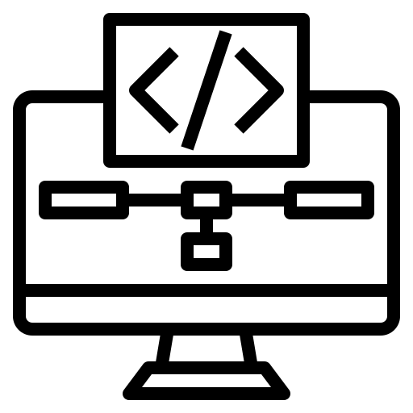





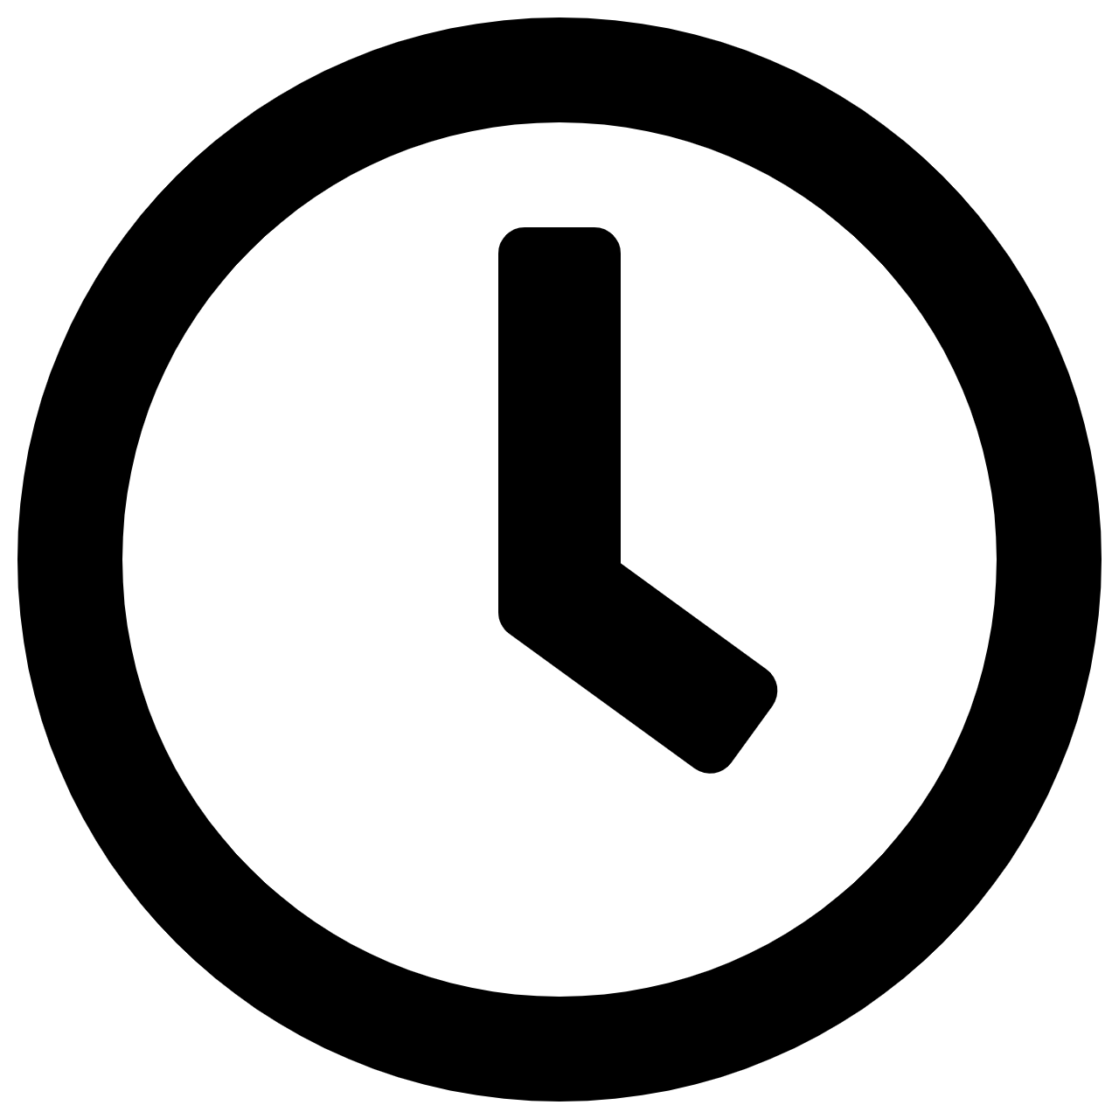
Study 1: Feasibility of our approach
Findings 1: Behavior-driven microtask workflow is feasible
Implemented 350 microtasks, 13 functions, 36 unit-tests, 613 LOC
Findings 2: Speed of onboarding and contributing is acceptable
Onboarded < 24 minutes, completion a microtasks < 4 minutes
Findings 3: Implementing microservice through microtasks is feasible
79% of the ToDo app implemented correctly
ToDo application
Interview + Survey
Crowd Microservices
150 & 120 min
Aghayi, Emad., et al. "Crowdsourced Behavior-Driven Development." Journal of Software and Systems,2020 (under review).
Notes:
To investigate the feasibility of applying behavior-driven microtask programming to implementing microservices, we conducted a user study in which a crowd of workers built a small microservice.
We recruited 9 participants to build a small microservice for a ToDo application and then analyzed their environment interactions and the resulting code they created.
We split our study into two sessions to reduce participant fatigue as well as to simulate participants returning to work after a delay.
All nine participants participated in the first session and five participated in the second session.
The first session was 150 minutes, and the second 120 minutes.
In the survey and interview we asked several open-ended questions focused on onboarding challenges, the granularity of microtasks, the ability to choose a task, motivation working using microtask programming, and interactions between crowd workers.

Slide 8


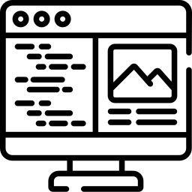
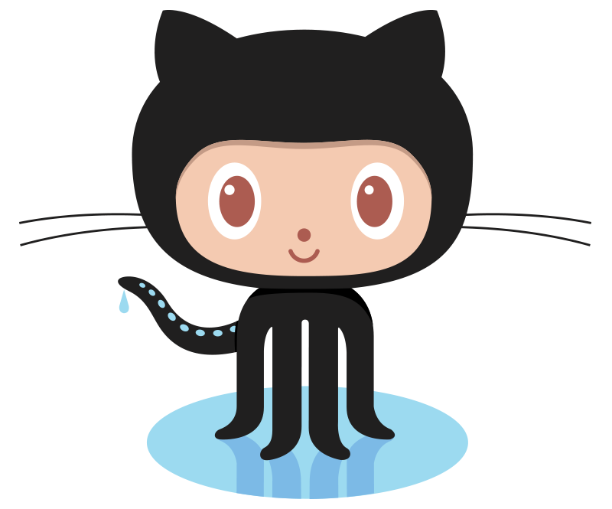
Study 2: Microtask programming Vs. traditional development
Survey
Crowd Microservices
Online-shopping app
240 min
Survey
Regular environments
Online-shopping app
240 min
Notes:
To directly compare traditional programming to microtasked programming, we conducted a controlled experiment.
28 developers worked either on traditional programming tasks, described through issues, or programming microtasks.
35% of participants were student in computer science or a related field, and 65 reported working as a software engineer.
They had a median of 2.0 years experience in JavaScript.

Slide 9
Study 2: Comparing microtask programming to traditional development
 | Description | Traditional development | Microtask programming
Onboarding | Writing first LOC (min) | 44 | 20
 | Completing first task (min) | 156 | 22
Time to market | Percent of logic implemented correctly | 13% | 75%
Maintainability | Easy to read or make changes to the code. (1 to 5) | 3.3 | 3.6
Individual productivity | Behaviors covered per hour | 1.5 | 2.2
Notes:
To directly compare traditional programming to microtasked programming, we conducted a controlled experiment.
28 developers worked either on traditional programming tasks, described through issues, or programming microtasks.
35% of participants were student in computer science or a related field, and 65 reported working as a software engineer.
They had a median of 2.0 years experience in JavaScript.

Slide 10
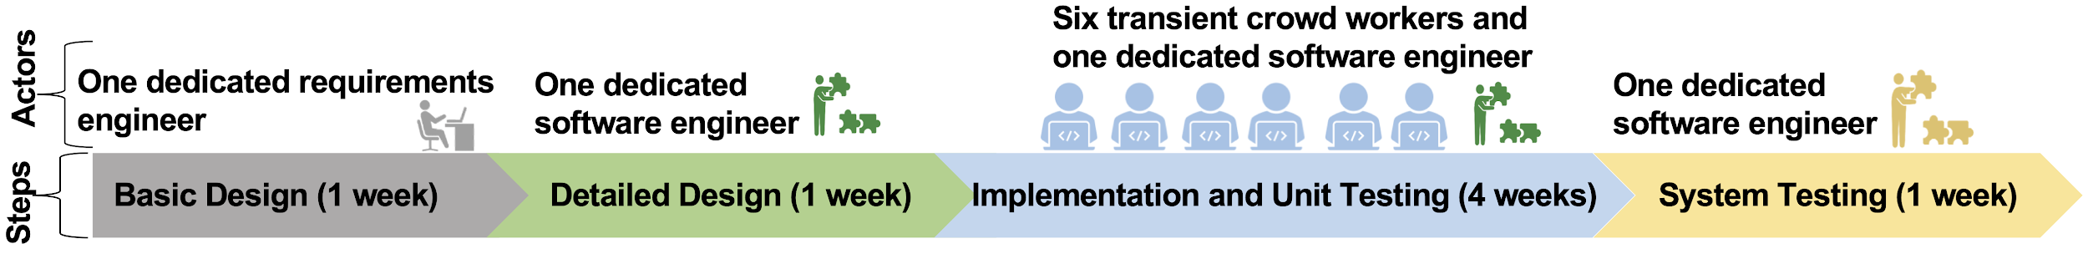
Study 3: Using microtask programming in industry
Aghayi, Emad., et al. "Can Microtask Programming Work in Industry?." ESEC/FSE 2020 industry paper.
Notes:
Our early studies were conducted entirely in artificial contexts, using artificial tasks and developers recruited specifically to work in the study. To examine the potential for using microtask programming in industry, we partnered with NTT, a large telecommunication company, to conduct a study of microtask programming within a real software project.

Slide 11



Study 3: Using microtask programming in industry
Interview + Survey
Findings 1: Software engineer successfully worked with microtask workflow in industry
Implemented 129 microtasks, 14 functions, 36 unit-tests, 8000 LOC
Findings 2: Implementing application through microtasks in industry is possible
Contained only small numbers of defects
Findings 3: Challenges of microtask programming for developers
Onboarding costs to be reduced
Fine with the reduced face to face communication
Experienced challenges with motivation
Aghayi, Emad., et al. "Can Microtask Programming Work in Industry?." ESEC/FSE 2020 industry paper.

Slide 12
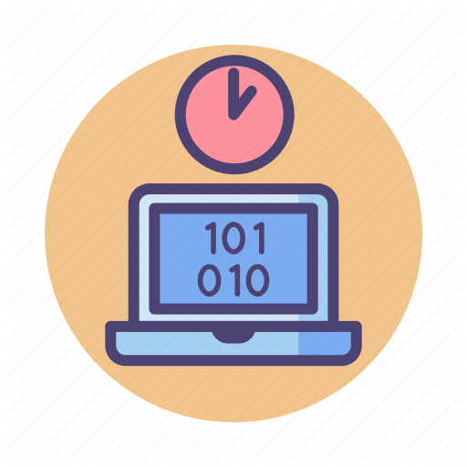
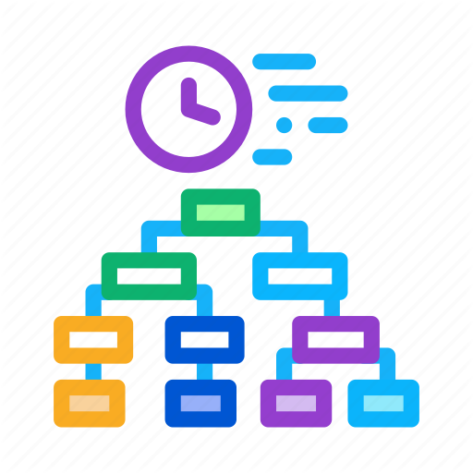
Future work
Study 1: Feasibility
Study 2: Controlled lab study
Study 3: In industry
Study 4: Large-scale
Study 5: Team organization
Notes:
My studies have offered initial evidence that microtask programming can be effective in small crowds with a few developers. But much of the promise of microtasking comes from large crowds, and there exists a direct relationship between the number of independent tasks and the parallelism in microtask programming which may reduce time to market.
To begin to examine microtask programming at scale, we are planning to conduct a virtual hackathon with around 100 developers.
One direction we expect to pursue is with team organization. In our current approach, clients specify a microservice and crowd developers work in a flat organization to complete microtasks. This organization may not work well for all projects. For instance, some projects have security considerations, like private APIs that they do not want to expose to the public. Or projects may benefit from more experienced team leads who tackle more complex tasks or help less experienced developers when they get stuck.

Slide 13
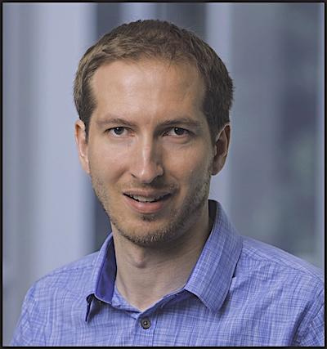
Acknowledgement
This work was supported in part by the National Science Foundation under grants CCF-1414197 and CCF-1845508.
Thomas LaToza
Notes:
I’d like to thank to my PhD advisors, Professors Thomas LaToza, for supporting me during these past 3 years.

Slide 14
Large-Scale Microtask Programming
Emad Aghayi
Department of Computer Science

Slide 15
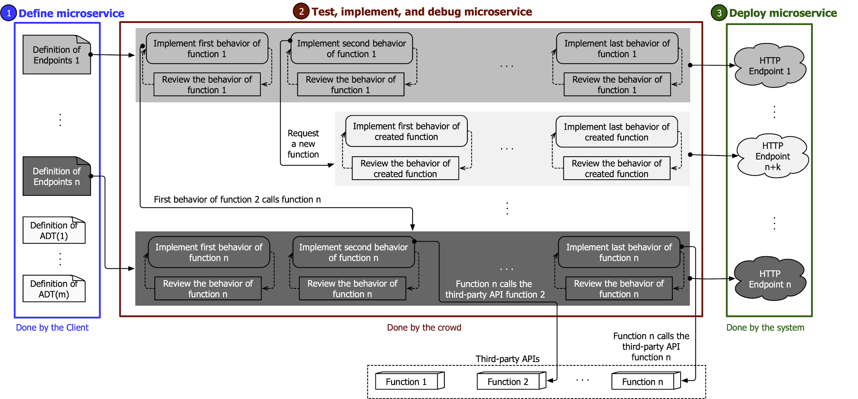
Crowdsourced behavior-driven development workflow
Notes:
(1) Define microservices: The client first writes a Client-Request to define a microservice to implement.
(2) Test, implement, and debug microservice: The system generates microtasks as necessary to implement each endpoint.
(3) Deploy microservice: After implementation is complete, the client may deploy the microservice.

Slide 16
Future work
Large scale microtask programming
Examine microtask programming at scale by conduct a virtual hackathon with around 100 developers.
Team organization
Exploring ways to make better use of more experienced developers in crowds through defining separate roles for crowd workers.
Notes:
My studies have offered initial evidence that microtask programming can be effective in small crowds with a few developers. But much of the promise of microtasking comes from large crowds, and there exists a direct relationship between the number of independent tasks and the parallelism in microtask programming which may reduce time to market.
To begin to examine microtask programming at scale, we are planning to conduct a virtual hackathon with around 100 developers.
One direction we expect to pursue is with team organization. In our current approach, clients specify a microservice and crowd developers work in a flat organization to complete microtasks. This organization may not work well for all projects. For instance, some projects have security considerations, like private APIs that they do not want to expose to the public. Or projects may benefit from more experienced team leads who tackle more complex tasks or help less experienced developers when they get stuck.
We will explore ways to make better use of more experienced developers in crowds through defining separate roles for crowd workers.

Slide 17
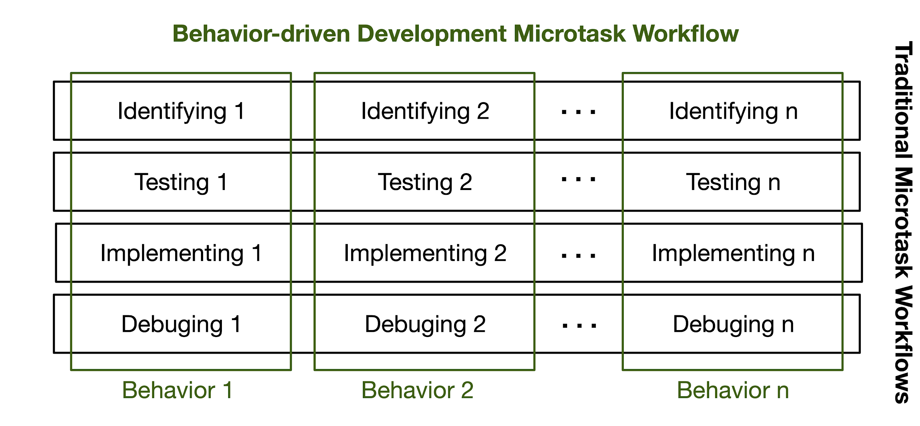

Crowd Microservices: A feedback based behavior-driven microtask programming
Notes:
We tried to answer those questions?
We introduced a new approach for feedback based on behavior-driven development.
Each microtask contains the work to test and implement a behavior.
A behavior is a specific identifiable use case of a function.
Developers work on a behavior end-to-end. They identify behavior from a high-level description of a function, write a test to exercise it, implement it in code, and debug any issues that emerge.
In contrast to existing approaches which rely on either a client or manager or later crowd contributions, we enable developers to receive initial feedback within the microtask itself.
Developers receive feedback through through syntax errors, running unit tests, and the ability to debug their code
We implemented our approach in a web based IDE that we named it Crowd Microservices.

Slide 18
Study 2: Comparing microtask programming to traditional development
 | Description | Traditional development | Microtask programming
Onboarding | To write first LOC (min) | 44 | 20
 | To complete first task(min) | 156 | 22
Time to market | Percent of logic of app implemented correctly. Traditional 4 hours of one developer. Microtask programming 4 hours of 7 parallelized developers. | 13% | 75%
Maintainability | Being easy to read or make changes to the code. Clarity, Simplicity, Consistency. (1 to 5) | 3.3 | 3.6
Individual productivity | Numbers of behaviors/logic covered by individual developers? (behaviors per hour) | 1.5 | 2.2
Notes:
To directly compare traditional programming to microtasked programming, we conducted a controlled experiment.
28 developers worked either on traditional programming tasks, described through issues, or programming microtasks.
35% of participants were student in computer science or a related field, and 65 reported working as a software engineer.
They had a median of 2.0 years experience in JavaScript.

Slide 19
Crowd Microservices
Possible to build an application
Decontexulizing of tasks to the scopes of behaviors
Quick feedback avoid conflicts among developers
Outperforms traditional software development
Works fine in industry
Notes:
My studies have offered initial evidence that microtask programming can be effective in small crowds with a few developers. But much of the promise of microtasking comes from large crowds, and there exists a direct relationship between the number of independent tasks and the parallelism in microtask programming which may reduce time to market.
To begin to examine microtask programming at scale, we are planning to conduct a virtual hackathon with around 100 developers.
One direction we expect to pursue is with team organization. In our current approach, clients specify a microservice and crowd developers work in a flat organization to complete microtasks. This organization may not work well for all projects. For instance, some projects have security considerations, like private APIs that they do not want to expose to the public. Or projects may benefit from more experienced team leads who tackle more complex tasks or help less experienced developers when they get stuck.

Slide 20
Study 3: Using microtask programming in industry
Interview + Survey
Findings 1: Software engineer successfully worked with microtask workflow in industry
Implemented 129 microtasks, 14 functions, 36 unit-tests, 8000 LOC
Findings 2: Implementing application through microtasks in industry is possible
Contained only small numbers of defects
Findings 3: Challenges of microtask programming for developers
Onboarding costs to be reduced
Fine with the reduced face to face communication
Experienced challenges with motivation
Aghayi, Emad., et al. "Can Microtask Programming Work in Industry?." ESEC/FSE 2020 industry paper.

